Slide 1
HackASU
Claude Builder Club Hackathon
March 20 – 22, 2026 | PSH 150 / 151
Thank you for being here!
We're excited to see what you build this weekend.

Slide 2




Critical Requirements
Check-in 2 of 3 Days
You must check in on at least 2 of the 3 hackathon days to be eligible for prizes.
Submission Requirements — Due Sunday 2:00 PM (HARD DEADLINE)
YouTube Video
Public GitHub Repository
Deployed Link
(if using Vercel or similar, you must give us permissions to view)
Use Claude Tooling
Projects must incorporate Claude / Anthropic tools in a meaningful way.

Slide 3

Our Sponsors
Serpico AI
Learning Center
Airpost
InsForge
Automation
Interns
Hiring AI Operations Specialist (part-time)
Hiring Full-Time AI SDE — technical & non-technical welcome
Free API credits for participants (YC '26)
Hiring AI SDE & Operations Interns
Red Bull
Tamagrow
TinyFish
Ada
Free Red Bull!
Turn GitHub commits into social posts
Free suite credits, prizes, accelerator golden tickets
Hiring SDE Interns
Thank you to all our sponsors for making HackASU possible!
Claude Builder Club | HackASU | March 20–22, 2026

Slide 4
1a
Biology & Physical Health
How can you improve access to healthcare, accelerate diagnosis, or help people manage physical health?
The Problem
Example Ideas
Healthcare is expensive, inaccessible, and confusing. Medical knowledge that could help people is locked behind jargon and paywalls. Billions lack access to quality care, and even those with access struggle to navigate complex systems.
Diagnostic aids for underserved clinics
Patient education platforms
Medication adherence tools
Symptom assessment and triage
Health literacy for treatment decisions
Accessibility tools for navigating healthcare
Ethical Considerations
Medical accuracy — when should this hand off to a real professional?
Privacy of deeply sensitive health data
Bias in medical AI across different populations
Transparency about limitations and when professional care is needed
Claude Builder Club | HackASU | March 20–22, 2026

Slide 5
1b
Mental Health
How can you expand access to mental health support or provide evidence-based therapeutic tools?
The Problem
Example Ideas
Mental health support is severely inadequate. There aren't enough therapists, stigma prevents help-seeking, quality care is gatekept by insurance and geography, and many people suffer without understanding what's happening to them.
Always-available therapeutic support (evidence-based)
Mental health literacy and psychoeducation
Tools for recognizing when you need professional help
Stress and burnout prevention
Peer support facilitation
Accessibility tools for neurodivergent individuals
Ethical Considerations
Crisis situations — when does someone need immediate human intervention?
Privacy and stigma around mental health data
Cultural competence in mental health approaches
Not replacing human connection when it's needed
Claude Builder Club | HackASU | March 20–22, 2026

Slide 6
2
AI Tooling
How can you make AI more useful, reliable, or accessible through better developer tools and infrastructure?
The Problem
Example Ideas
AI capabilities are advancing fast, but the tooling around them hasn't kept up. Developers struggle with fragmented workflows, unreliable integrations, and steep learning curves. The gap between what AI can do and what developers can easily build with it remains wide.
Developer workflow automation with Claude
MCP server integrations for new domains
AI-powered debugging or code review tools
Prompt engineering and evaluation frameworks
Infrastructure for reliable AI agent orchestration
Tools that make AI accessible to non-technical users
Ethical Considerations
Reliability — what happens when AI tools fail in production?
Security implications of AI-generated code
Transparency in how AI tools make decisions
Ensuring tools empower developers rather than create dependency
Claude Builder Club | HackASU | March 20–22, 2026

Slide 7
3
Economic Empowerment & Education
How can you help people learn, gain skills, find opportunities, or improve their economic situation?
The Problem
Example Ideas
Opportunity isn't equal. Quality education and economic advancement are gatekept by geography, wealth, and language. Talent is universal, but access to support isn't.
Adaptive tutoring
Career transition guidance
Financial literacy for underserved communities
Job interview prep
Small business / nonprofit support
Scholarship matching and language learning
Ethical Considerations
Who gets excluded by your design (tech, literacy, language)?
Impact of bad advice when guiding careers or education
Empowering informed choices vs. making choices for people
Cultural assumptions about what 'success' means
Claude Builder Club | HackASU | March 20–22, 2026

Slide 8
4
Governance & Collaboration
How can you help people participate in democracy, work together across differences, or make collective decisions?
The Problem
Example Ideas
Democratic institutions are strained. Polarization makes productive dialogue difficult. Civic participation is down because people feel powerless or confused. Communities can't coordinate around shared challenges.
Community deliberation platforms
Policy explanation tools
Legislative transparency
Grassroots organizing support
Participatory budgeting
Conflict mediation and voter education
Ethical Considerations
How could this be weaponized for manipulation or suppressing dissent?
Whose voices get centered vs. drowned out?
Handling factual disputes vs. 'both-sidesing' reality
Privacy in civic participation
Claude Builder Club | HackASU | March 20–22, 2026

Slide 9
5
Creative Flourishing
Build something that amplifies human creativity, helps people find meaning, or supports cultural expression.
The Problem
Example Ideas
As AI handles routine work, questions about human purpose become urgent. Access to creative development and cultural preservation isn't equal. People who could find meaning through creative expression often don't get the chance.
Community storytelling platforms
Music/art education with real-time feedback
Writing development tools
Language and cultural preservation
Intergenerational knowledge exchange
Purpose exploration guides
Ethical Considerations
Keeping humans as creators, not just AI prompters
Enhancing vs. short-cutting the creative process
Cultural appropriation vs. respectful celebration
Creating vs. destroying value for creative workers
Claude Builder Club | HackASU | March 20–22, 2026

Slide 10

Judging Rubric
100 Points Total
Impact Potential
25 pts
Technical Execution
30 pts
Is this a real problem? Who does it affect and why does it matter?
Does the core functionality work? Does it demonstrate the idea effectively using AI?
Ethical Alignment
25 pts
Presentation
20 pts
Did the team think seriously about potential harms? Does this empower people?
Can the team clearly explain what they built, why, and what they'd do next?
Claude Builder Club | HackASU | March 20–22, 2026

Slide 11

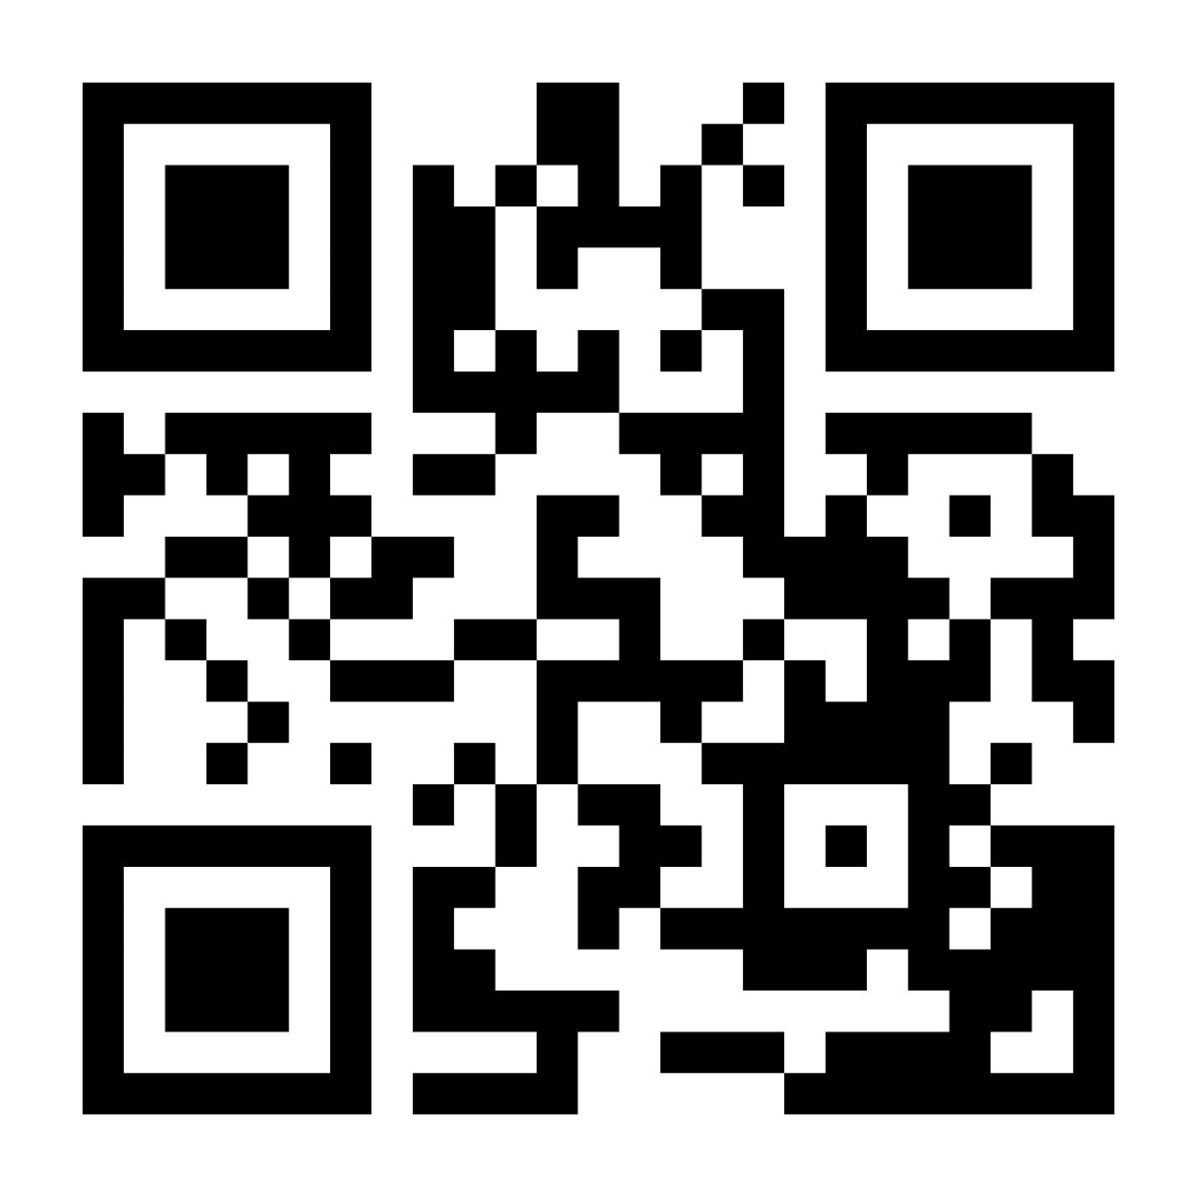
Go Viral, Win Big
Sponsored by Tamagrow
Most Viral Hackathon Post
Post about your hackathon experience on any platform — X, LinkedIn, TikTok, Instagram, or anything else.
1st Place
Keychron K4 Keyboard
2nd Place
Monitor
Top 2 people with the most viral posts win these prizes. You can optionally use Tamagrow's platform, but any platform counts.
If no one reaches 1,000+ engagement, prizes will be reallocated to the Grand Prize pool.
Claude Builder Club | HackASU | March 20–22, 2026

Slide 12
Prizes & Opportunities
1 Winning Team Per Track
$300 in API Credits
Interview Pool for Sponsor Startups
Tracks:
Track 1: Biology & Physical / Mental Health
Track 2: AI Tooling
Track 3: Economic Empowerment & Education
Track 4: Governance & Collaboration
Track 5: Creative Flourishing
Claude Builder Club | HackASU | March 20–22, 2026

Slide 13

Free Resources
TinyFish — Free API Credits
Sign up using this link to get free TinyFish suite credits for the hackathon:
https://agent.tinyfish.ai/makeasplash?source=asuclaudehack
Also: prizes for social posts, cookbook PRs, and accelerator golden tickets for winners!
InsForge — Free Backend Credits
Enter this promo code to get free InsForge backend credits:
INSFORGEXASU
Claude Builder Club | HackASU | March 20–22, 2026

